Slide 1
Week 11: Architecture
CSE 270 Software Testing

Slide 2
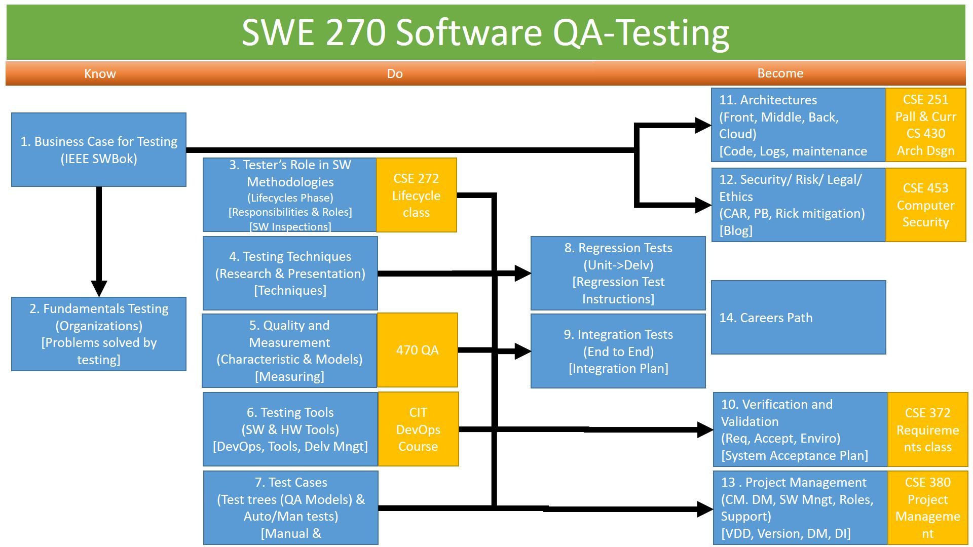
Overview
Preview week review
Reading

Slide 3
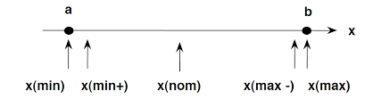
Review
What is the pattern to a test case?
When do we start testing? When do we end?
What are the two directions of testing? What do we use for each?
What are the different levels of testing? Visibility?
Can we test everything? What can we test?
Data: (0,1,*,+/-,^, !, =, <>), Accuracy vs Precise
Test-to-Pass(happy path) and Test-to-Fail (force error messages)
Flows – Workflow, transition, Logic.
Quality Characteristics and Models
Boundary Edges (0, 1, *, +/-, ^, !, = <>)
Zero, One, Many test (01*)– This type of test checks if the inputs are accepting normal values.
Zero(0) represent nothing. Nothing is different depending on the desired input(int =0, float=0.0, char=’ ‘ or ‘\t’ or ‘\n’ or 0, string=”” empty string or any single char white space).
1- One represents the first nominal test, i.e. 1, 2, 3, …n values that should be expected.
Many(*-regular expression wild card) tests how the program handles multiple types or multiple values.
+/- Plus or minus one – boundary
Power of 2s - (2^x), ASCII/UNICODE
Not the data: Invalid, Incorrect, garabage
Thresholds – above and below margin of error
Boundary Testing (<>) – This type of test checks where the inputs fail, usually providing different type data, length boundaries, invalid values, etc. The program should be able to handle this.

Slide 4
Videos

Slide 5
Reading
Integration Testing
Please open the O'Reilly e-book Software Testing, 4th Edition by Paul C. Jorgensen. Read Chapter 13: Integration Testing.

Slide 6
Redo an Assignment
Select a Redo
You and your partner(s) will have the opportunity to redo any of the previous ten labs. Select a lab and notify your instructor which lab it will be.

Slide 7
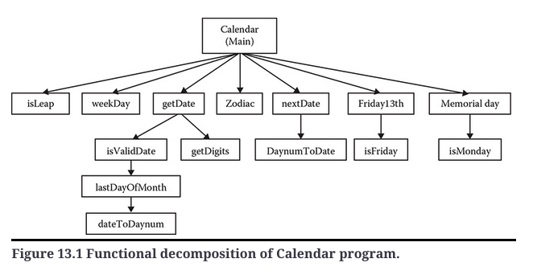
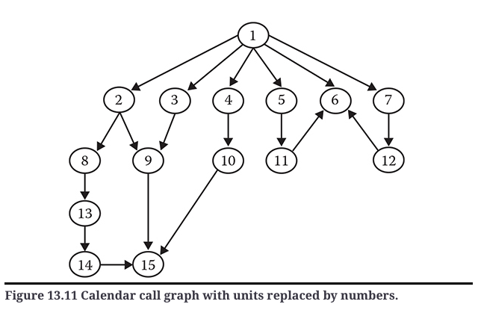
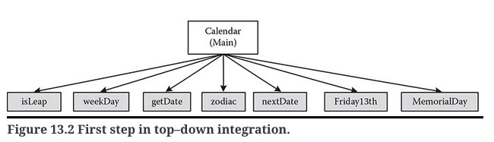
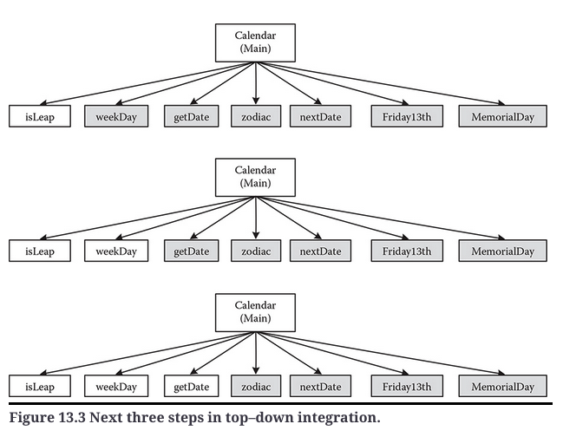
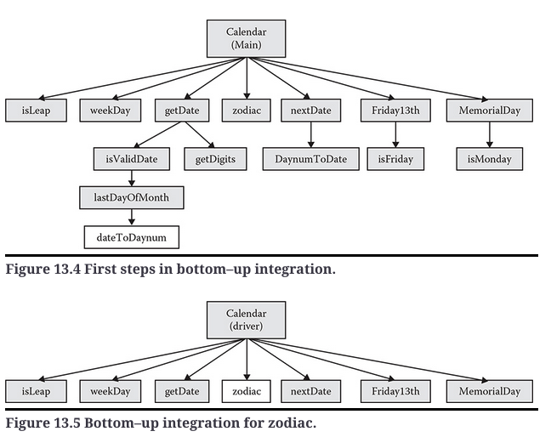
Software Testing, 4th Edition by Paul C. Jorgensen Chapter 13: Integration Testing
13.1 Decomposition-Based Integration
13.1.1 Top–Down Integration
13.1.2 Bottom–Up Integration
13.1.3 Sandwich Integration
13.2 Call Graph–Based Integration
13.2.1 Pairwise Integration
13.3 Path-Based Integration
13.3.1 New and Extended Concepts
13.3.2 MM-Path Complexity (Method-Message)
13.4 Example: integrationNextDate
13.4.1 Decomposition-Based Integration
13.4.2 Call Graph–Based Integration
13.4.3 MM-Path-Based Integration
13.5 Conclusions and Recommendations
Strategy Basis | Ability to Test Interfaces | Ability to Test Co-Functionality | Fault Isolation Resolution
Functional decomposition | Acceptable but can be deceptive | Limited to pairs of units | Good, to faulty unit
Call graph | Acceptable | Limited to pairs of units | Good, to faulty unit
MM-path | Excellent | Complete | Excellent, to faulty unit execution path

Slide 8
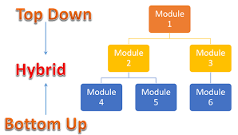
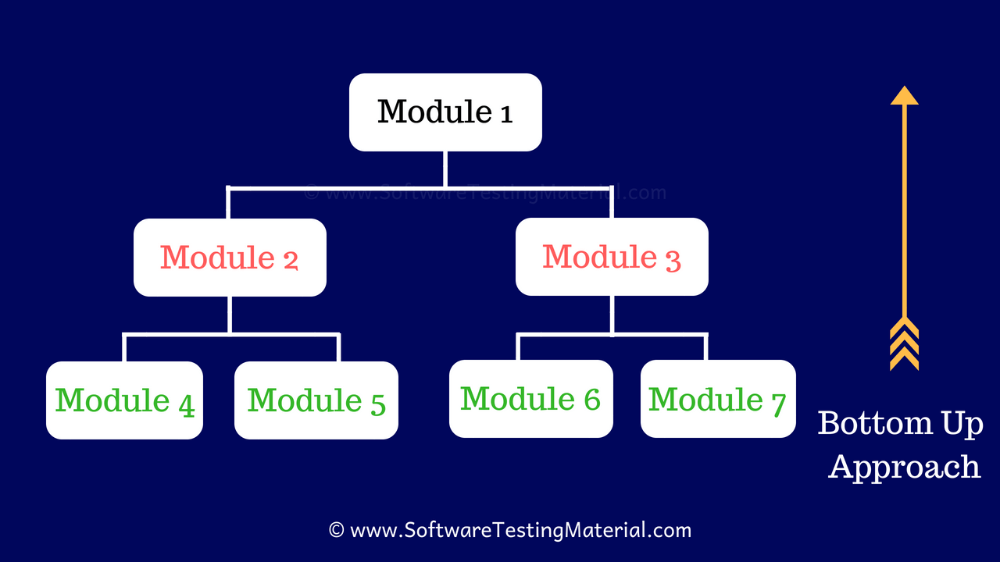
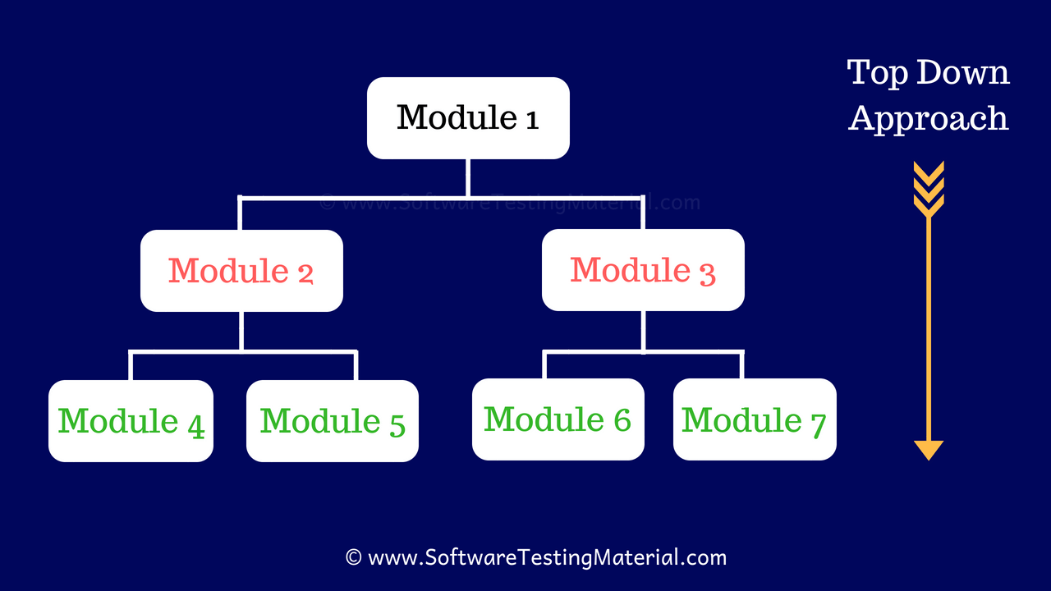
Software Testing, 4th Edition by Paul C. Jorgensen Top-Down vs Bottom-Up Test Design
Requirements &
Design
sandwich, and the vividly named “big bang.”
Quality Models
Quality Characteristics

Slide 9
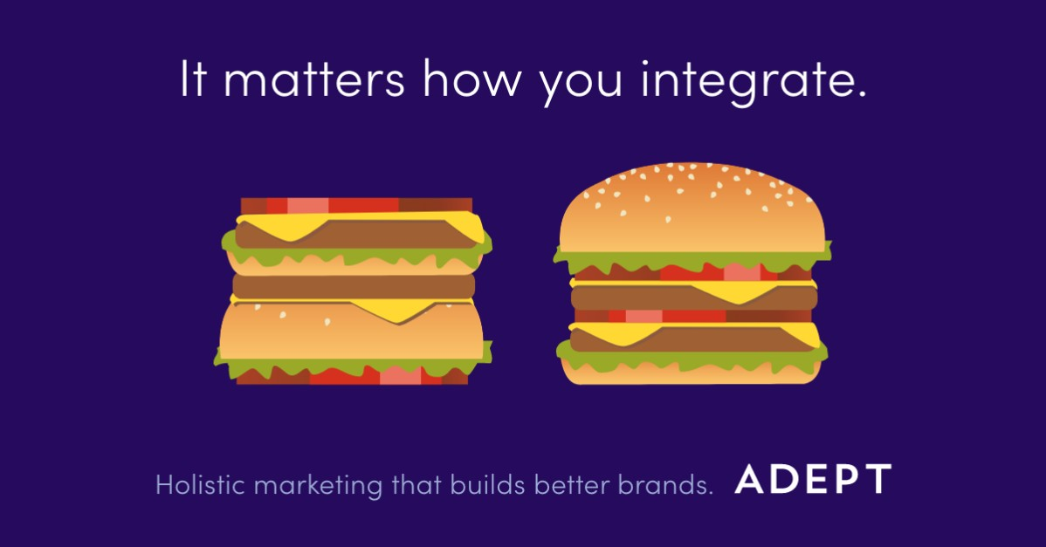
Software Testing, 4th Edition by Paul C. Jorgensen

Slide 10
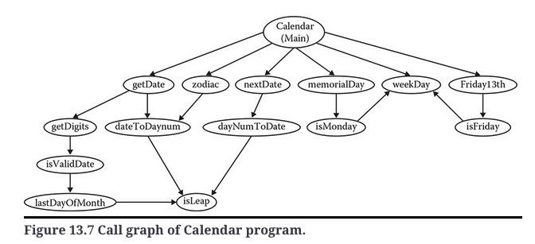
Software Testing, 4th Edition by Paul C. Jorgensen
Top Down
Pairwise
Stubs
Pairwise
Stubs
Neighbor
N=1
Driver
Driver
Bottom-Up

Slide 11
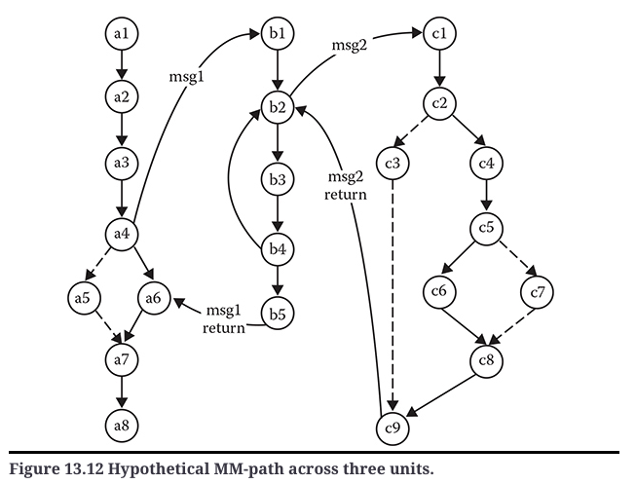
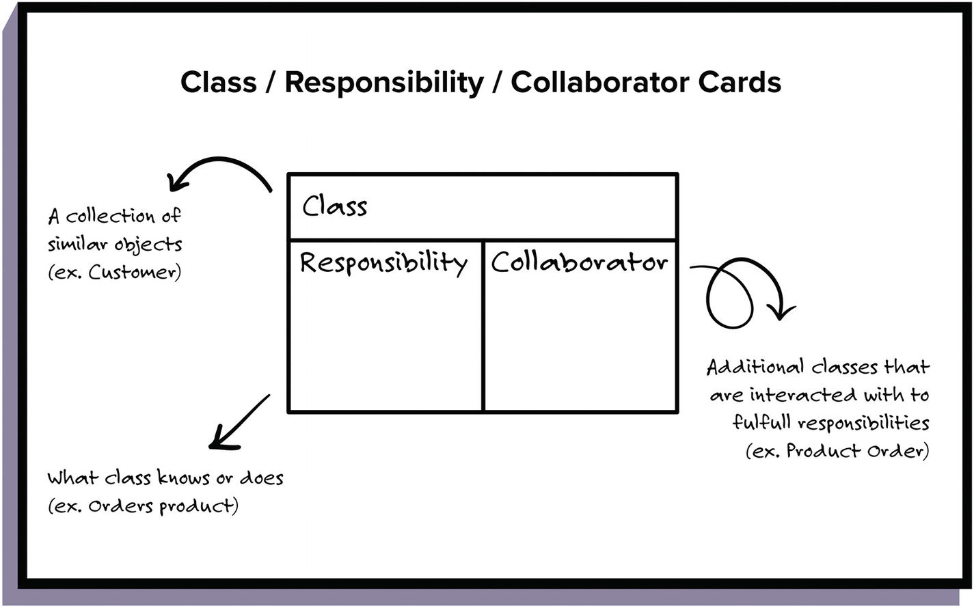
Software Testing, 4th Edition by Paul C. Jorgensen
MM-Path
Module-Message
OO: Method-Message
CRC Cards: Class –Responsibility – Collaborators
Example
MVC
View
Front-End
Control
Middle
Model
BackEnd

Slide 13
Software Testing, 4th Edition by Paul C. Jorgensen Published by Auerbach Publications, Strategies of Development Testing
The whole mechanism is that units are integrated with respect to structure;
Fundamental uncertainty exists in any structural form of testing
As part of Integration You are testing
Data Paths
Workflows
Business Logic

Slide 14
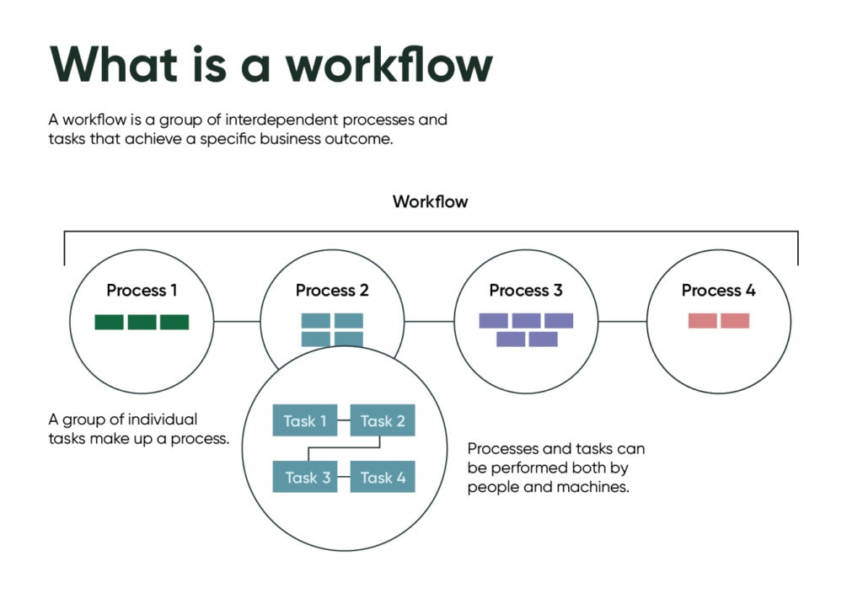
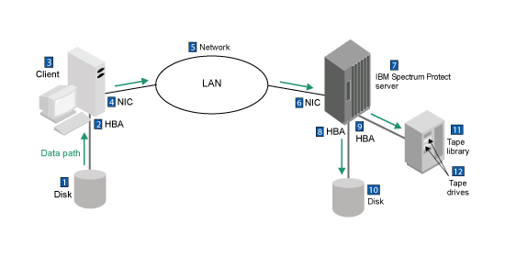
Path-Based: Workflow, Data
Author mentioned MM-path – covers every conceivable path, lots of overhead.
Workflow: This is the normal, expect path for accomplishing a goal
Data Flow Path: Follow the data.
Process flow:

Slide 15

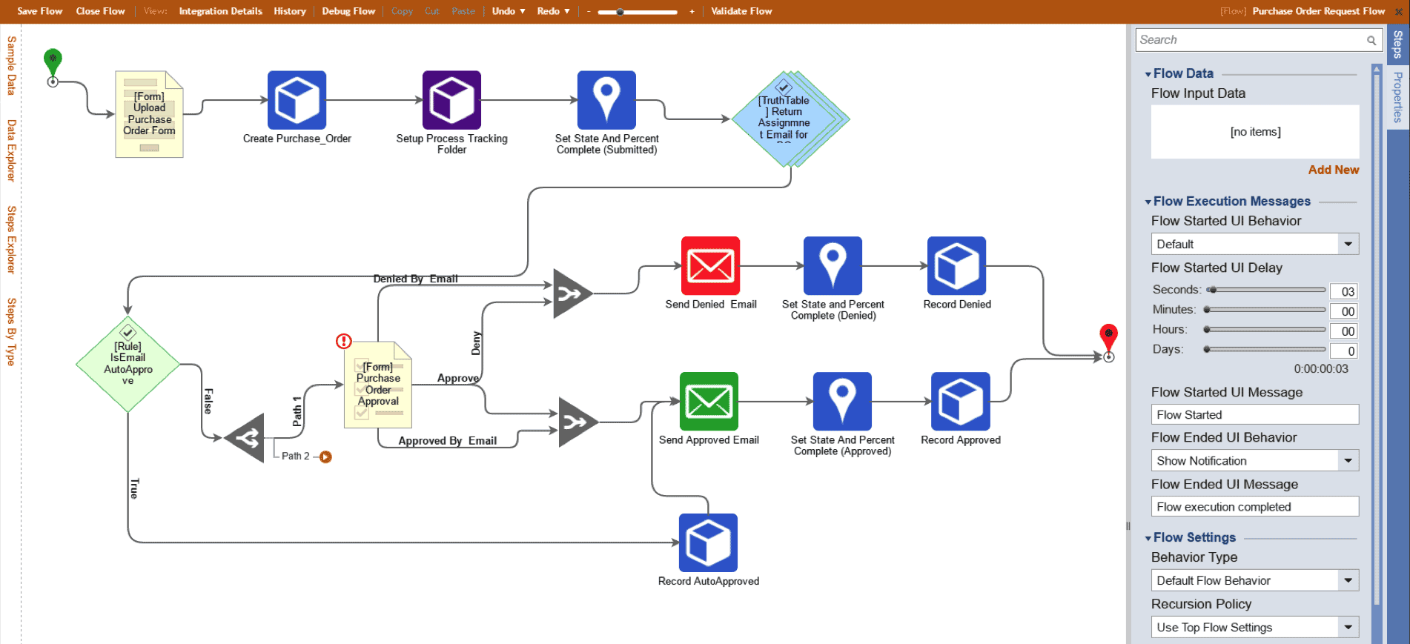
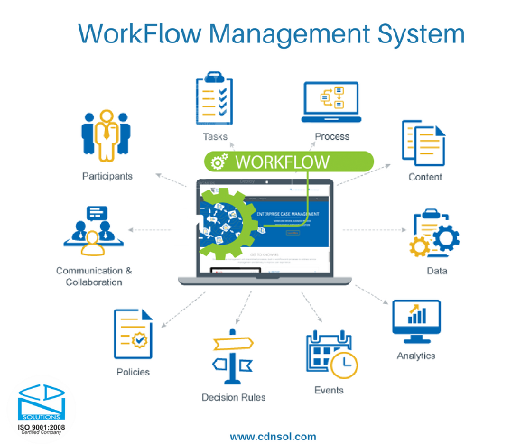
Flows
Workflow
Elements
Actor, Message, Decisions/Variables
Purpose/Goal (Start, Finish)
Workflow
Logical Data Flow
Process Flow
Control Flow
Functional Flow

Slide 16
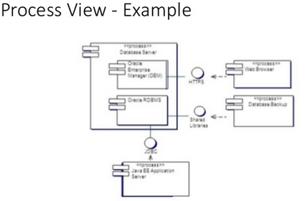
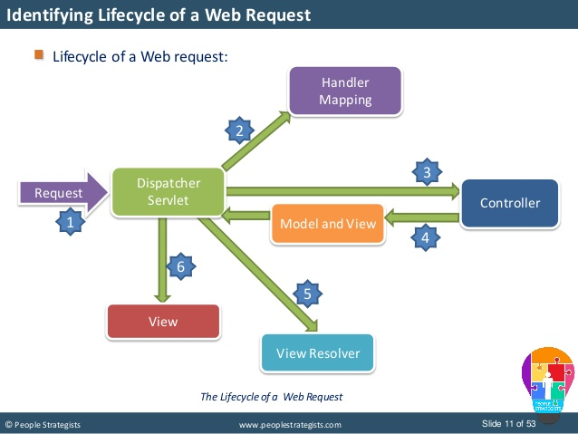
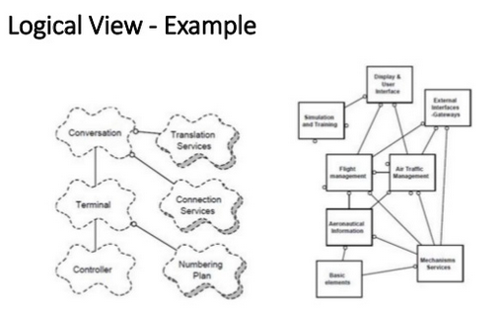
Flows
Process
Logical Data Flow

Slide 17
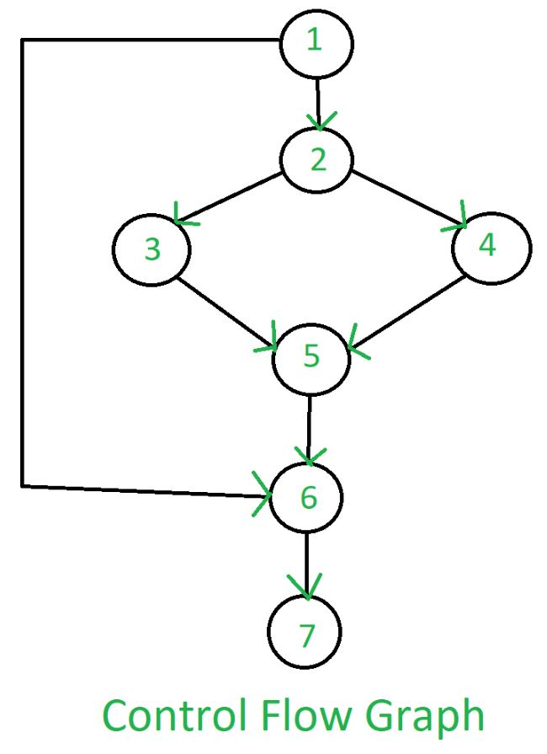
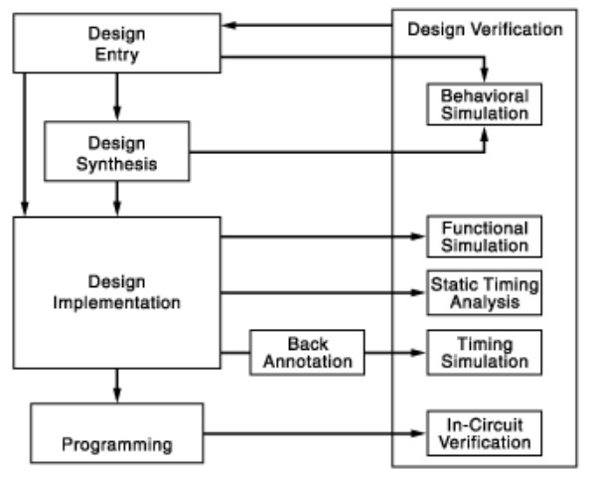
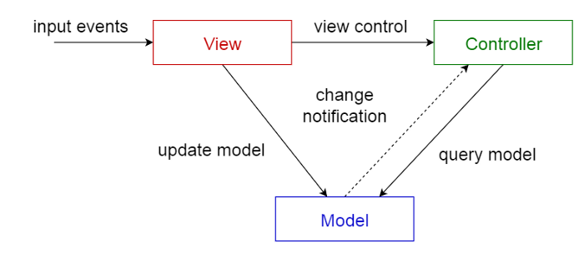
Flows
Control Flow
Functional Flow

Slide 18
Another way of looking at things…
So Far:
Architecture
Design Patterns
Quality Models

Slide 19
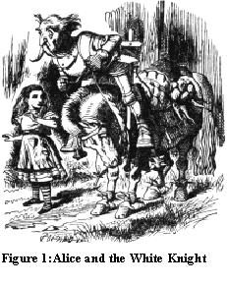
A song, a song, its time to sing a song…
In the scene, Alice is walking with the White Knight, and they have just finished coming to end of woods. Alice’s expression are mis-interrupted by the Knight:
“Alice could only look puzzled: she was thinking of the pudding. `You are sad,' the Knight said in an anxious tone: `let me sing you a song to comfort you.' `Is it very long?' Alice asked, for she had heard a good deal of poetry that day. `It's long,' said the Knight, `but it's very, very beautiful. Everybody that hears me sing it -- either it brings the tears into their eyes, orelse --' `Or else what?' said Alice, for the Knight had made a sudden pause. `Or else it doesn't, you know. The name of the song is called "Haddocks' Eyes".' `Oh, that's the name of the song, is it?' Alice said, trying to feel interested. `No, you don't understand,' the Knight said, looking a little vexed. `That's what the name is called. The name really is "The Aged Aged Man".' `Then I ought to have said "That's what the song is called"?' Alice corrected herself. `No, you oughtn't: that's quite another thing! The song is called "Ways and Means": but that's only what it's called, you know!' `Well, what is the song, then?' said Alice, who was by this time completely bewildered. `I was coming to that,' the Knight said. `The song really is "A-sitting On a Gate": and the tune's my own invention.' So saying, he stopped his horse and let the reins fall on its neck: then, slowly beating time with one hand, and with a faint…”[ ]

Slide 20
Four ways of looking at something…
Four Definitions | Example 1 | Example 2(int A = 2;) | Example 3 (OO)
The name of the song is called | National Anthem | Integer | Declaration
The name is called | Song | A | Instance
The song is called | “Oh say can you see” | Value/Variable | Definition
The song is | America the Beautiful | 2 or Number | Symbolizes

Slide 21
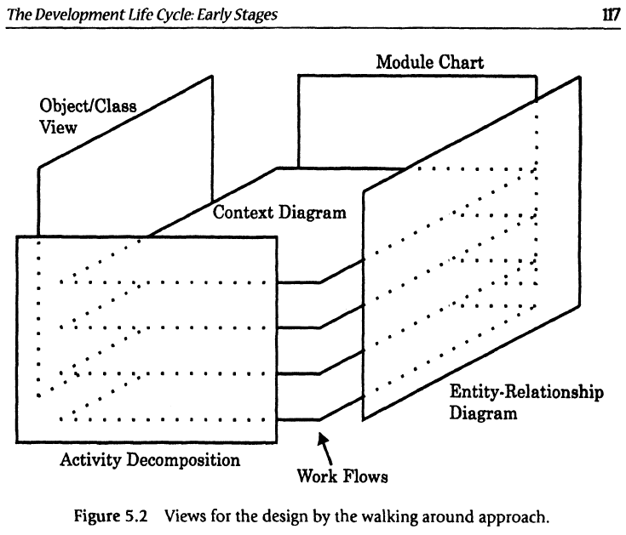
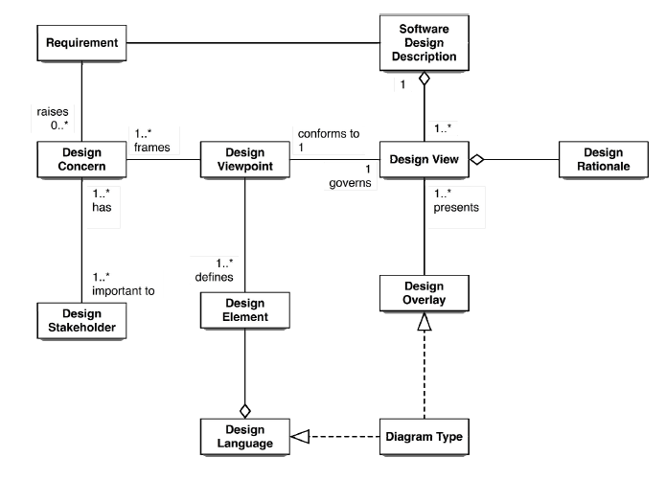
Design terms
Design concern
Area of interest
Design view
One or more design elements to address a set of design concerns
Design viewpoint
Specification of elements and conventions for construction of a design view
Only 1
Design element
Entity, relationship, attribute, constraint
Design entity
Distinct for other elements
Design relationship
Connection correspondence
Design constraint
Rule, restriction
Design attribute
Characteristic

Slide 22
Access to Data: Resetting Password
Design Concern
Given User information is accessible to preferences.
Authentication process
Admin needs to access user information to provide support and corrective actions.
Authentication process
Authorization process
Design Elements
User Properties
Admin access to User Properties
Design View
Password Change for User
Password Change Admin for User
Design View Point
User view point to password change
Admin view point to password change

Slide 23
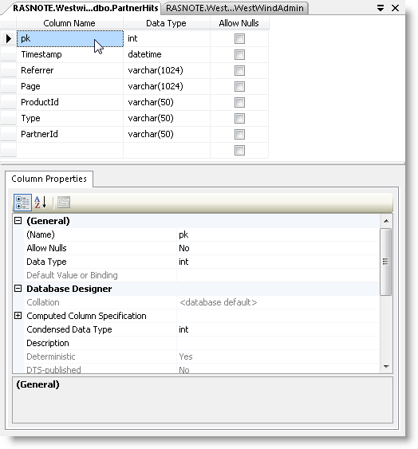
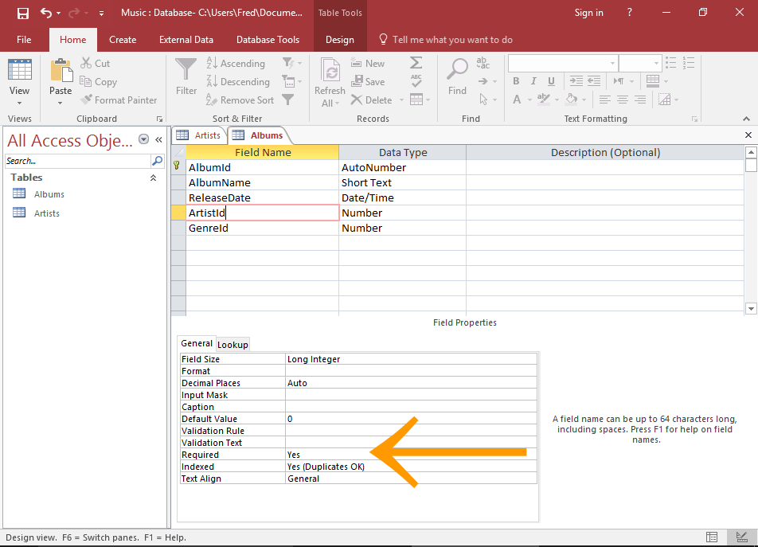
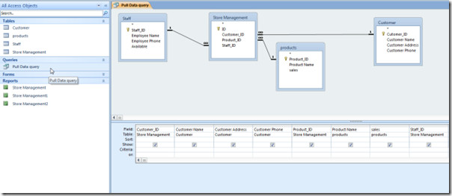
Access to Data: Database Table
Design Concern
Permission Database Table
Design Elements
Table Field Names:
Design View
Tables
Column Properties
Fields
Design View Point
Column Properties
Table Relationships
Field Properties

Slide 24
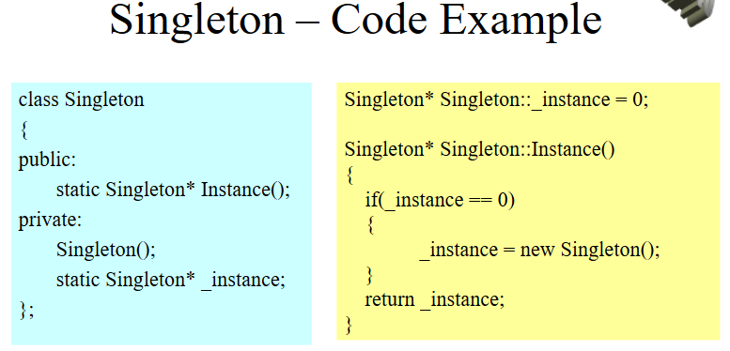
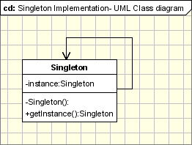
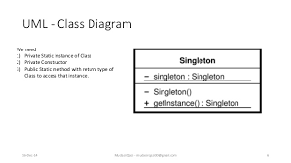
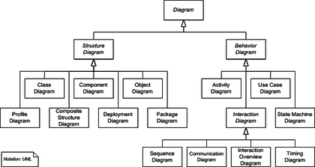
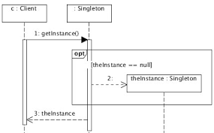
Access to Data: Class Diagram
Design Concern
Singleton to Access connection to database.
Design Elements
“There can only be one”
Is-A
Has-A
Design View
Inheritance, Class, Relationships, Patterns, Flow
Design View Point
Inheritance Diagram
Class Diagram
CRC
Design Pattern
Sequence

Slide 25
Access to Data: Techniques are the Design Views
Design Concern
N-Tier
Design Elements
API, Interfaces
State Controls
Data Distribution
Design View
Design View Point
State Diagram
Process Flow
Petri Net
Layering
Workflow
Data & control flow

Slide 26
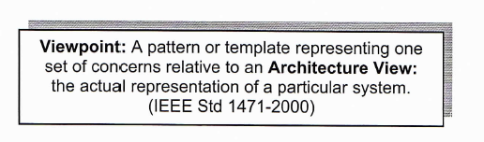
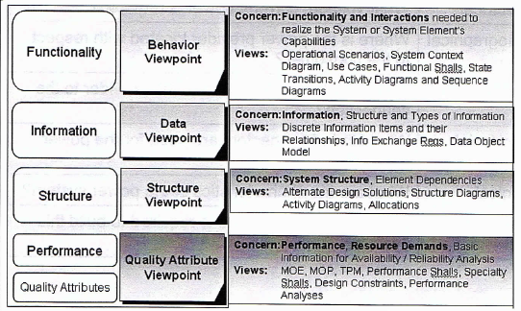
Raytheon: Viewpoint

Slide 27
Design Views
Language Abilities
Assembly
Compiler
Interpretative
Platform Independent
Java
Language Independent
.NET
Complier Independent
??
Design Level
Function
Class
Library
Interface
Sub-component
Entity
Multi-Entity
Sub-System
N-Tier
System
Architecture
Framework
Platform
Client-Server
2,3,n-tier
Cloud
Component
Data
Event-driven
Layered
Peer-2-peer
Rule-based
Service-oriented (SOA)
REST
Web
Mobile Application
Pipe and Filter
Microkernel
Quality Models
View points
Structure
Machine
Assembly
Basic (Goto)
Modular (libraries)
Control Structures
Goto -> decision (if/switch); loops (for/while)
Functional
Goto modules -> functions (scope)
Object Oriented/Event Control
Access Control
Design Patterns
Data
Registers
Variables (types)
Homogeneous Structures (array)
Heterogeneous Structures (structs)
Data Structures (Lists)
Classes(structs w/ functions)
DataBase
XML
On the wire
Serialize
Run Time
Single/Multi process
Threads (mutex), comm.
Network processing
Marshalling
As a Platform

Slide 28
Teach
Answer each of the questions from the list below. Answer the questions by researching the topic and provide a summary for each group of questions. Make sure you cite your sources, you need to have at least two others, other than the readings.
Pick two of the software architectural terms.
Complete the following:
Defining each of the terms?
Which non-functional requirement would best test the architecture? ( See week 5: Reading Miguel’s Review of Quality Models)
How would you go about creating a test for it?
Terms:
Client-Server:, Component,Data ,Event-driven,Layered,Peer-2-Peer, Rule-based,Service-oriented (SOA),Web Services, Mobile, N-tier, Database, Event-driven, Cloud (PaaS, SaaS, etc):
Research one of the types of flows identify, and answer the questions below
Flows
Data Flow
Process Flow
Workflow
Control Flow
Functional Flow
Questions
What is the purpose of the flow?
What insights does the flow provide to testing at the unit, integration, system or acceptance level?

Slide 29
Integration Of Architecture

Slide 30
Skill: Full Stack Front End Middle Back End Back End
Most us have heard of full stack developer.
Here I am going to break up the full stack in to:
Front End: HMI, GUI or Terminal
Middle: Business Logic, Server
Back End: Database or File System

Slide 31
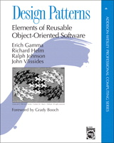
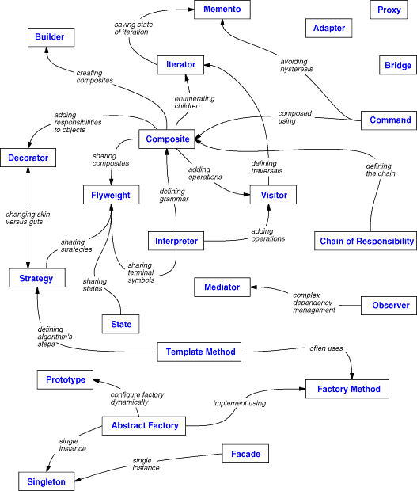
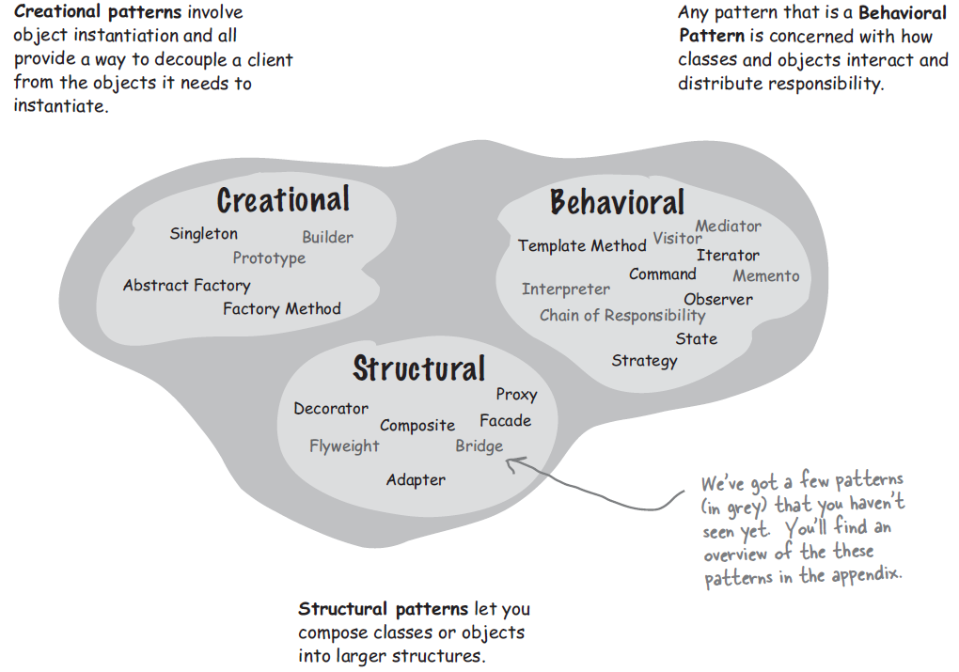
Skill: Full Stack Front End Middle Back End Back End
Design Pattern (MVC)
View Control Model
HMI, GUI, Terminal, Logs
Servers, Peer-to-Peer, Cloud (PaaS, SaaS, etc)
Databases, Files, etc
Controller
View
Model
Another way of thinking about it
Is using the MVC Design Pattern

Slide 33
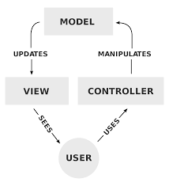
Skill: Full Stack Front End Middle Back End Back End
Design Pattern (MVC)
View Control Model
Model
File System
Database
Controller
Controller
Controller
View
View
View
View
View
Model
Model
Each of MVC can have a MVC.
Where the views of the components MVCs
Connect the Architectures MVCs.
HMI, GUI, Terminal, Logs
©2019 W. Clements – BYU-Idaho v190206

Slide 34
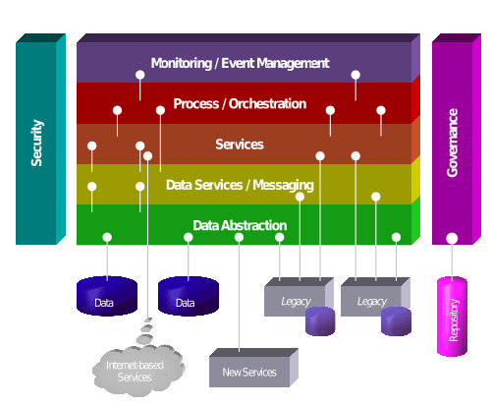
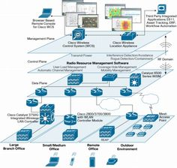
Skill: Full Stack Front End Middle Back End Back End
Design Pattern (MVC)
View Control Model
Model
N-Tier Capabilities
File System
Database
View
Controller
Controller
Controller
View
View
View
View
View
Model
The Architecture Control can also have addition views
If the control is talking to other processes in a N-tier architecture
If the control is using 3 party Interfaces
View
Model
HMI, GUI, Terminal, Logs
3-Party Interfaces
©2019 W. Clements – BYU-Idaho v190206
Notes:
https://blogs.mulesoft.com/wp-content/uploads/2011/04/SOA_Metamodel.png

Slide 35
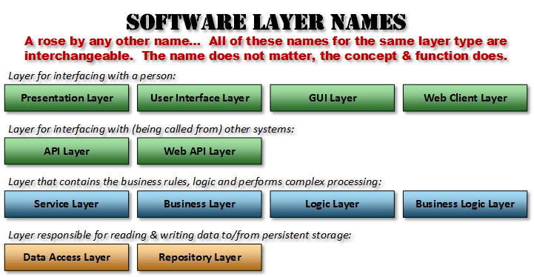
Skill: Full Stack Front End Middle Back End Back End
Design Pattern (MVC)
View Control Model
Model
Public API
Library Interface
Coupling
View
Controller
Cohesion
Controller
Controller
View
View
View
View
Interfaces
Interfaces
View
Coupling
Cohesion
Coupling
Model
View
Model
Coupling
Cohesion
The Views are where interfaces are established.
3 Party API/Interfaces
3 Party Pkg/Libraries
©2019 W. Clements – BYU-Idaho v190206

Slide 36
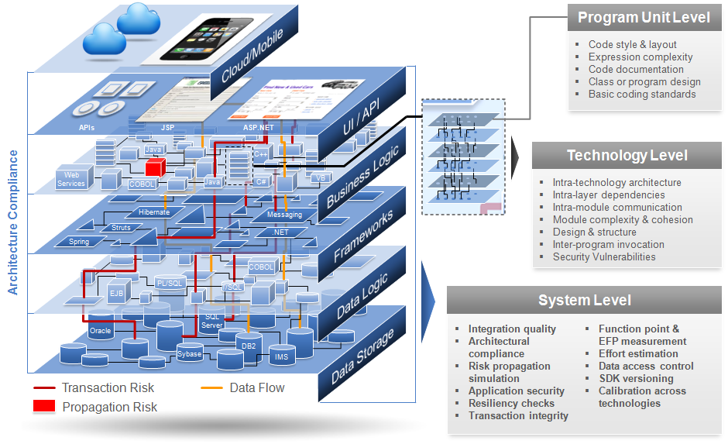

Slide 37
Skill: Full Stack Front End Middle Back End Back End
Design Pattern (MVC)
View Control Model
This is a good time to identify the difference between code that process data and code that is data.
Code that is data usually has three states:
Data in Process – At the Control
Data in Motion/Transit – Between the Views
Data at Rest – is usually found in the Model
Model
Public API
Library Interface
Data at Rest
View
Data in Process
Controller
Data in Process
Controller
Data in Process
Controller
View
View
View
View
Interfaces
Interfaces
Data at Motion/Transit
Data at Motion/Transit
View
Model
View
Model
Data at Rest
3 Party API/Interfaces
3 Party Pkg/Libraries
Data at Rest
©2019 W. Clements – BYU-Idaho v190206

Slide 38
Skill: Full Stack Front End Middle Back End Back End
Design Pattern (MVC)
View Control Model
Look at Controller, is can be more than one process. Each process handles one or more algorithms. Many times other Design Patterns can be used like Observer, Chain of Command, etc.
Model
Public API
Library Interface
Data at Rest
View
Data in Process
Controller
Events
Data in Process
Controller
Data in Process
Processes
Processes
Controller
View
View
View
View
DBMS
Processes
Processes
Observer
Algorithms
Interfaces
Interfaces
Data at Motion/Transit
Data at Motion/Transit
View
Model
View
Model
Data at Rest
3 Party API/Interfaces
3 Party Pkg/Libraries
Data at Rest
©2019 W. Clements – BYU-Idaho v190206

Slide 39
Skill: Full Stack Front End Middle Back End Back End
Design Pattern (MVC)
View Control Model
Look at Model, usually contains Class, Structures, Types along with Data Structures.
In the back end, the model would be in the form of tables and files.
Model
Public API
Library Interface
Class/Struct/Types
Data Structures
Data at Rest
View
Data in Process
Controller
Events
Data in Process
Controller
Data in Process
Processes
Processes
Controller
View
View
View
View
DBMS
Processes
Processes
Observer
Algorithms
Interfaces
Interfaces
Data at Motion/Transit
Data at Motion/Transit
View
Model
Class/Struct/Types
View
Data Structures
Model
Data at Rest
Tables
Data at Rest
Files
3 Party API/Interfaces
3 Party Pkg/Libraries
Data at Rest
©2019 W. Clements – BYU-Idaho v190206

Slide 40
Skill: Full Stack Front End Middle Back End Back End
Design Pattern (MVC)
View Control Model
Additional Structures:
Look at Views, are bit more complex.
Front End deals with User Experience: Human Machine Interface, Human Computer Interface, or User Interface, within Web, Mobil or OS applications
The Middle deals with interface with APIs and Libraries
The Backend stores and retrieves the data.
Model
Public API
Library Interface
Class/Struct/Types
Data Structures
Data at Rest
View
Interfaces
Data in Process
As you can see, multiple Design pattern, such as Facades, Adaptor, wrap around the Interfaces.
Adaptors
Controller
Facades
Events
Data in Process
Controller
Data in Process
Processes
Processes
Controller
View
View
View
View
DBMS
Facades
Facades
Processes
Processes
Facades
Facades
Adaptors
Adaptors
Observer
Algorithms
Adaptors
Adaptors
Interfaces
Messaging
Interrupts
Notifications
Remote Function
Interfaces
Data at Motion/Transit
Data at Motion/Transit
SQL
View
Control used algorithms
HMI
HCI
UI
States/Session(Stateless):
New/Init.
Modify/Edit
Inactive
Delete/Destroy
HMI
HCI
UI
Model
HMI
HCI
UI
Class/Struct/Types
Models hold data structures
View
Data Structures
Model
Web (HTML, CSS, JS)
Mobil Apps
OS Applications
?
Facades
Data at Rest
Tables
Adaptors
Files
Interfaces
3 Party API/Interfaces
3 Party Pkg/Libraries
Data at Rest
©2019 W. Clements – BYU-Idaho v190206

Slide 41
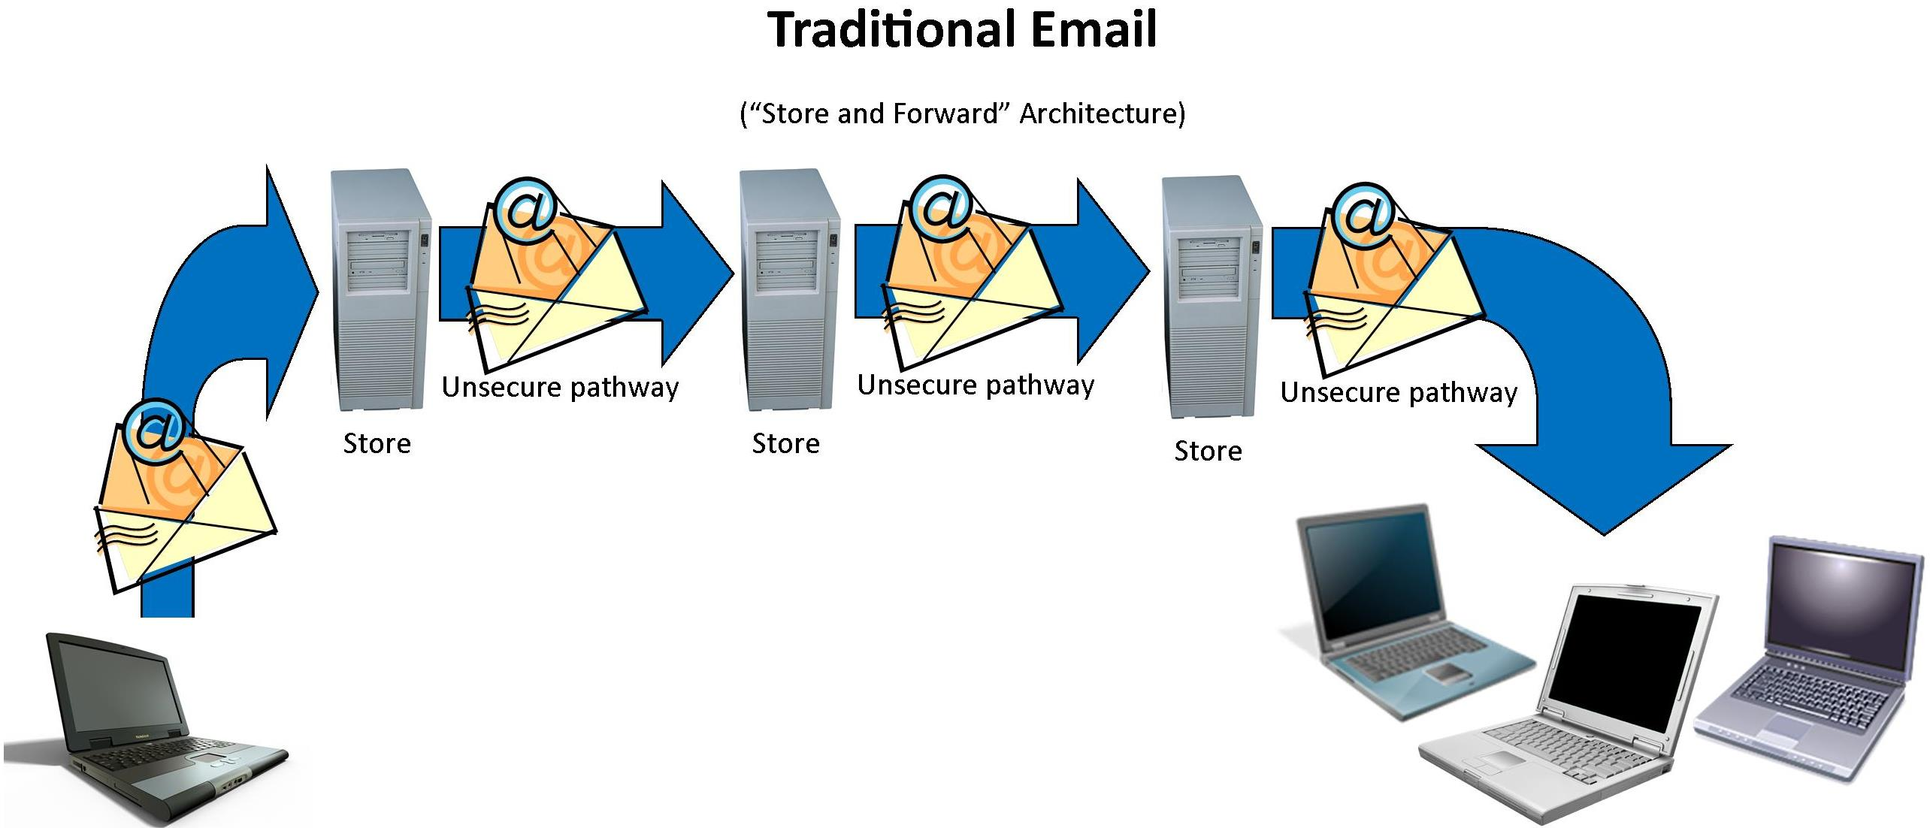
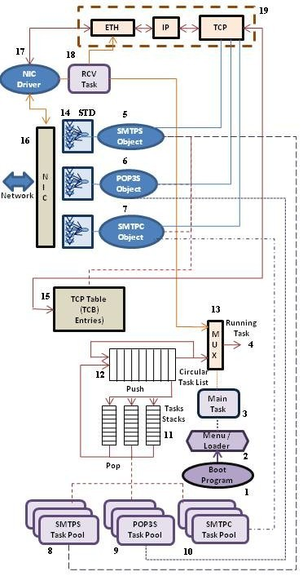
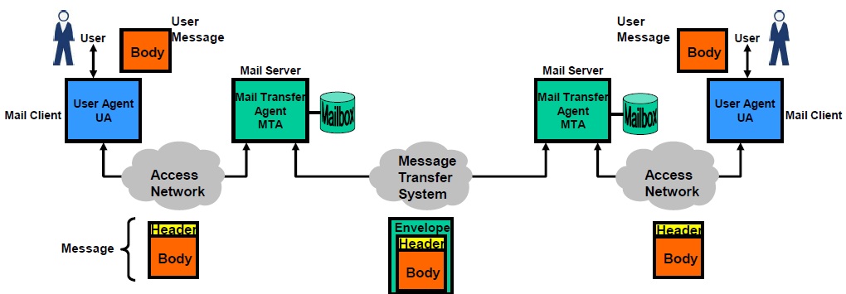
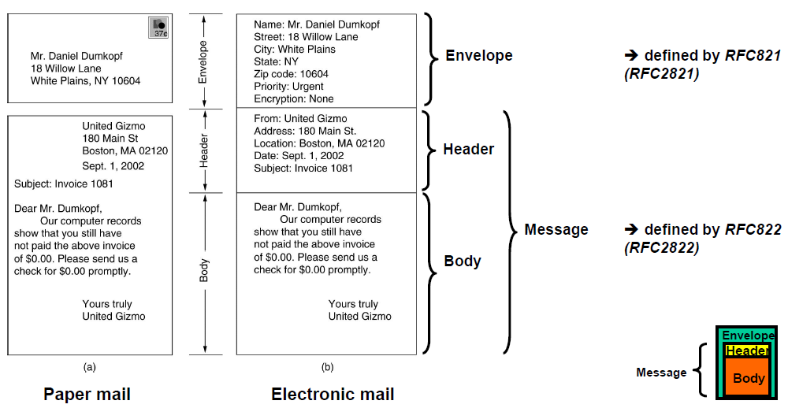
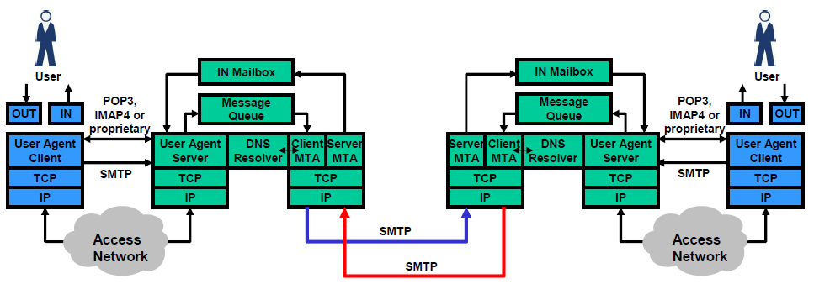

https://www.slideshare.net/PeterREgli/email-6106131

Slide 42


Slide 43

Testing w Stubs and Drivers
STUBS | DRIVERS
Stubs used in Top Down Integration Testing | Drivers used in Bottom Up Integration Testing
Stubs are used when sub programs are under development | Drivers are used when main programs are under development
Top most module is tested first | Lowest module is tested first
It can simulate the behavior of lower level modules that are not integrated | It can simulate the behavior of upper level modules that are not integrated
Stubs are called programs | Drivers are the calling programs

Slide 44
Skill: Full Stack Front End Middle Back End Back End
Design Pattern (MVC)
View Control Model
Model
Public API
Library Interface
Coupling
View
Controller
Cohesion
Controller
Controller
View
View
View
View
Interfaces
Interfaces
View
Coupling
Cohesion
Coupling
Model
View
Model
Coupling
Cohesion
3 Party API/Interfaces
3 Party Pkg/Libraries
©2019 W. Clements – BYU-Idaho v190206

Slide 45
Tasks, Workflows, Business Logic

Slide 46
Skill: Full Stack Front End Middle Back End Back End
A task in a program is the process of action and results.
Design Pattern (MVC)
View Control Model
Model
Controller
Controller
Processes
Controller
View
View
View
View
View
Model
Model
©2019 W. Clements – BYU-Idaho v190206

Slide 47
Skill: Full Stack Front End Middle Back End Back End
Design Pattern (MVC)
View Control Model
Model
Controller
View
View
Controller
Processes
Model
Controller
View
View
View
Model
Lets make some room
©2019 W. Clements – BYU-Idaho v190206

Slide 48
Skill: Full Stack Front End Middle Back End Back End
Design Pattern (MVC)
View Control Model
View
Model
Controller
View
View
Controller
Controller
View
Processes
Model
Model
View
©2019 W. Clements – BYU-Idaho v190206

Slide 49
Skill: Full Stack Front End Middle Back End Back End
Simplified UML Sequence diagram
Design Pattern (MVC)
View Control Model
View
Model
Controller
View
View
Controller
Controller
View
Processes
Model
Model
View
©2019 W. Clements – BYU-Idaho v190206

Slide 50
Skill: Full Stack Front End Middle Back End Back End
Design Pattern (MVC)
View Control Model
View
Model
Controller
View
View
Controller
Controller
View
Processes
Model
Model
View
Link being click
Control sending request to server
Control sending request to server
Request being received by server
Request being processed
Request state being stored
Request’s parameters being pulled from Model
Parameters received
Data retrieved
From file
©2019 W. Clements – BYU-Idaho v190206

Slide 51
Skill: Full Stack Front End Middle Back End Back End
Design Pattern (MVC)
View Control Model
View
Model
Controller
View
View
Controller
Controller
View
Processes
Model
Model
View
Link being click
Control sending request to server
Control sending request to server
Request being received by server
Request being processed
Request state being stored
Request’s parameters being pulled from Model
Parameters received
Data retrieved
From file
Results data returned
Return data received
Data processed into information
Information returned
Information received
Results displayed
©2019 W. Clements – BYU-Idaho v190206

Slide 52


Skill: Full Stack Front End Middle Back End Back End
Going back to the basic diagram, a workflow is the process of a tasks being completed to solve business logic.
Design Pattern (MVC)
View Control Model
View
Model
Controller
View
View
Controller
Controller
View
Processes
Model
Model
View
1
Bring up Home Webpage
2
Click on Login
Workflow
3
Fill out Username and Password
4
Success Login, bring up Home Login Page
Examples of Workflows:
Logging in
Sending email
Submitting homework assignment
©2019 W. Clements – BYU-Idaho v190206

Slide 53


Business Logic -
Solves interoperability between systems
Solves more than end-to-end testing
Set of rules and strategies
Set of workflows

Slide 54
Skill: Full Stack Front End Middle Back End Back End
Business logic is programming workflows.
Design Pattern (MVC)
View Control Model
View
Model
Controller
View
View
Controller
Controller
View
Processes
Model
Model
View
if
©2019 W. Clements – BYU-Idaho v190206

Slide 55
Software Testing, 4th Edition by Paul C. Jorgensen
MM-Path
Module-Message
OO: Method-Message
CRC Cards: Class –Responsibility – Collaborators
Example
MVC
View
Front-End
Control
Middle
Model
BackEnd

